Slide 1

UNIVERSITY INSTITUTEOF ENGINEERING
Bachelor of Engineering (Computer Science & Engineering)
Operating System (CST-328)
Subject Coordinator: Er. Puneet kaur (E6913)
Introduction to Operating System
DISCOVER . LEARN . EMPOWER
Font size 24

Slide 2
Lecture 19 RAID structure- RAID levels & problems with RAID.

Slide 3
What is RAID?
The basic idea of RAID was to combine multiple small, inexpensive disk drives into an array of disk drives which yields performance exceeding that of a Single Large Expensive Drive (SLED). Additionally, this array of drives appears to the computer as a single logical storage unit or drive.
This concept is an example of storage virtualization

Slide 4
What is RAID
It is a way of storing the same data in different places (thus, redundantly) on multiple hard disks.
By placing data on multiple disks, I/O (input/output) operations can overlap in a balanced way, improving performance.
Since multiple disks increases the mean time between failures (MTBF), storing data redundantly also increases fault tolerance .

Slide 5
Why RAID?
RAID is now used as an umbrella term for computer data storage schemes that can divide and replicate data among multiple physical disk drives.
The physical disks are said to be in a RAID array , which is accessed by the operating system as one single disk.
The different schemes or architectures are named by the word RAID followed by a number (e.g., RAID 0, RAID 1).
Each scheme provides a different balance between two key goals:
increase data reliability & capacity
increase input/output performance.

Slide 6
The Different RAID Levels
RAID 0
RAID 1
RAID 2
RAID 3
RAID 4
RAID 5
RAID 6

Slide 7
RAID 0
In level 0, data is split across drives, resulting in higher data throughput.
Since no redundant information is stored, performance is very good, but the failure of any disk in the array results in data loss.
This level is commonly referred to as striping.

Slide 8
Striping
Fundamental to RAID is "striping", a method of concatenating multiple drives into one logical storage unit.
Striping involves partitioning each drive's storage space into stripes which may be as small as one sector (512 bytes) or as large as several megabytes.
This provides more data access throughput, which avoids causing the processor to idly wait for data accesses.
Striping is used across disk drives in RAID storage, network interfaces in Grid-oriented Storage, and RAM in some systems.

Slide 9
RAID 1
RAID Level 1 provides redundancy by writing all data to two or more drives.
The performance of a level 1 array tends to be faster on reads and slower on writes compared to a single drive, but if either drive fails, no data is lost.
This is a good entry-level redundant system, since only two drives are required; however, since one drive is used to store a duplicate of the data, the cost per megabyte is high.
This level is commonly referred to as mirroring.

Slide 10
Mirroring
In striping no fault tolerance but in mirroring provides 100% duplication of data.
Data written to one drive is duplicated on another provides excellent fault tolerance , if one disk is failure no data is lost.
The easiest way to get high availability and high performance.

Slide 11
RAID 2
RAID Level 2, which uses Hamming error correction codes, is intended for use with drives which do not have built-in error detection.
All SCSI drives support built-in error detection, so this level is of little use when using SCSI drives . Because 39 disks are required .

Slide 12
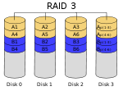
RAID 3
In RAID 3 (byte-level striping with dedicated parity), all disk spindle rotation is synchronized, and data is striped so each sequential byte is on a different disk.
Parity is calculated across corresponding bytes on disks and stored on a dedicated parity disk.

Slide 13
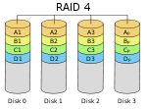
RAID 4
RAID Level 4 stripes data at a block level across several drives, with parity stored on one drive. The parity information allows recovery from the failure of any single drive.
The performance of a level 4 array is very good for reads (the same as level 0). Writes, however, require that parity data be updated each time. This slows small random writes, in particular, though large writes or sequential writes are fairly fast.
Because only one drive in the array stores redundant data, the cost per megabyte of a level 4 array can be fairly low.

Slide 14
RAID 5
RAID 5 (block-level striping with distributed parity) distributes parity along with the data and requires all drives but one to be present to operate; the array is not destroyed by a single drive failure.
Upon drive failure, any subsequent reads can be calculated from the distributed parity such that the drive failure is masked from the end user.
However, a single drive failure results in reduced performance of the entire array until the failed drive has been replaced and the associated data rebuilt.

Slide 15
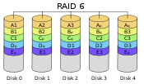
RAID 6
RAID 6 (block-level striping with double distributed parity) provides fault tolerance of two drive failures; the array continues to operate with up to two failed drives.
This makes larger RAID groups more practical, especially for high-availability systems.
This becomes increasingly important as large-capacity drives lengthen the time needed to recover from the failure of a single drive.
Single-parity RAID levels are as vulnerable to data loss as a RAID 0 array until the failed drive is replaced and its data rebuilt; the larger the drive, the longer the rebuild takes.
Double parity gives time to rebuild the array without the data being at risk if a single additional drive fails before the rebuild is complete.

Slide 16
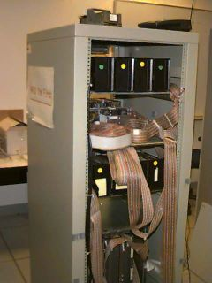
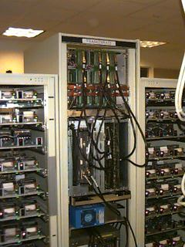
RAID
First RAID system
Second RAID system.

Slide 17
Conclusion
This lecture enables the students to understand the concept of RAID, its uses, RAID levels and associated problems.

Slide 18
Video Link
https://study.com/academy/lesson/raid-arrays-data-redundancy.html
https://www.youtube.com/watch?v=BZE4cIm23Js

Slide 19
References
https://www.javatpoint.com/os-disk-scheduling
https://www.cs.uic.edu/~jbell/CourseNotes/OperatingSystems/8_MainMemory.html#:~:text=8.3%20Contiguous%20Memory%20Allocation,allocated%20to%20processes%20as%20needed.
http://www.csdl.tamu.edu/~furuta/courses/99a_410/slides/chap08
https://www.geeksforgeeks.org/disk-scheduling-algorithms/
https://www.gatevidyalay.com/disk-scheduling-disk-scheduling-algorithms/
http://www.cs.iit.edu/~cs561/cs450/disksched/disksched.html

